Slide 1
Topic 6 – From Smart Contract to Dapp
Notes:
“Operating Systems: Internal and Design Principles”, 8/e, Global Edition by William Stallings, Chapter 5 “Concurrency: Mutual Exclusion and Synchronization”.

Slide 2
Topics to be covered
What is a DApp?
Read Chapter 12, Antonopoulos
Truffle – an IDE for DApp
Managing Dapp project.
Notes:
At first glance, it may seem that interleaving and overlapping represent fundamentally different modes of execution and present different problems. In fact, both techniques can be viewed as examples of concurrent processing, and both present the same problems. In the case of a uniprocessor, the problems stem from a basic characteristic of multiprogramming systems: The relative speed of execution of processes cannot be predicted. It depends on the activities of other processes, the way in which the OS handles interrupts, and the scheduling policies of the OS.

Slide 3
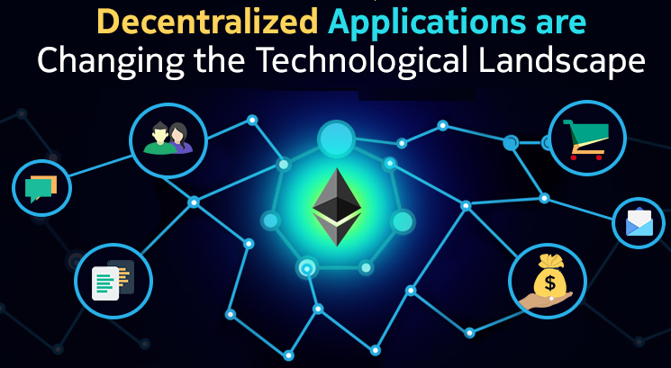
From Blockchain to Smart Contracts to DApps
First we discussed Blockchain in general.
And then we discussed smart contract/ethereum as a way to make a general-purpose blockchain that could be programmed for a variety of uses.
The smart contract really differentiates ethereum from other blockchains.
Notes:
At first glance, it may seem that interleaving and overlapping represent fundamentally different modes of execution and present different problems. In fact, both techniques can be viewed as examples of concurrent processing, and both present the same problems. In the case of a uniprocessor, the problems stem from a basic characteristic of multiprogramming systems: The relative speed of execution of processes cannot be predicted. It depends on the activities of other processes, the way in which the OS handles interrupts, and the scheduling policies of the OS.

Slide 4
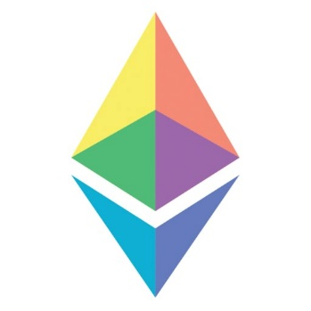
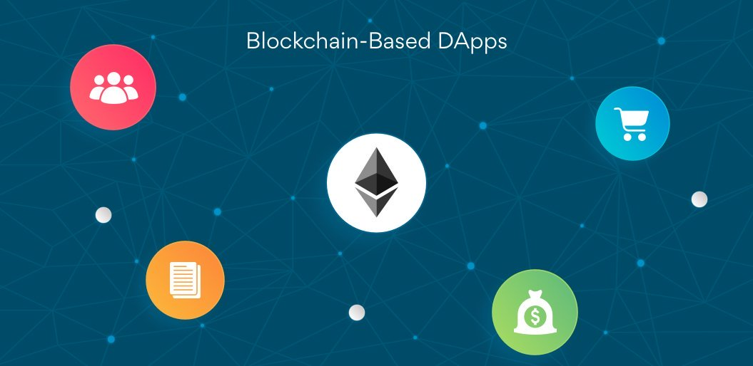
From Smart Contracts to DApps
Very quickly, Ethereum’s vision expanded from distributed/ decentralized ledger to become a platform for decentralized programming, called DApps.
DApps represent a broader applications than smart contracts.
Notes:
At first glance, it may seem that interleaving and overlapping represent fundamentally different modes of execution and present different problems. In fact, both techniques can be viewed as examples of concurrent processing, and both present the same problems. In the case of a uniprocessor, the problems stem from a basic characteristic of multiprogramming systems: The relative speed of execution of processes cannot be predicted. It depends on the activities of other processes, the way in which the OS handles interrupts, and the scheduling policies of the OS.

Slide 5
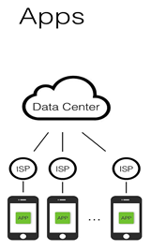
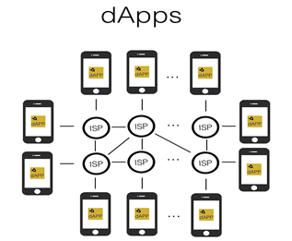
What is a DApp
DApp provides blockchain features to the outside world for query & interactions
DApp gives access to the blockchain for people, applications & systems (may not know each other) to transact in a p2p manner.
Centralized vs Decentralized.
Default vs More secure (redundancy)
Notes:
At first glance, it may seem that interleaving and overlapping represent fundamentally different modes of execution and present different problems. In fact, both techniques can be viewed as examples of concurrent processing, and both present the same problems. In the case of a uniprocessor, the problems stem from a basic characteristic of multiprogramming systems: The relative speed of execution of processes cannot be predicted. It depends on the activities of other processes, the way in which the OS handles interrupts, and the scheduling policies of the OS.

Slide 6
What is a DApp
A DApp is, at the very least, :
a smart contract and
a web user interface.
In addition, many DApps include other decentralized components, such as:
A decentralized (P2P) storage protocol and platform (swarm)
A decentralized (P2P) messaging protocol and platform (whisper)
Notes:
At first glance, it may seem that interleaving and overlapping represent fundamentally different modes of execution and present different problems. In fact, both techniques can be viewed as examples of concurrent processing, and both present the same problems. In the case of a uniprocessor, the problems stem from a basic characteristic of multiprogramming systems: The relative speed of execution of processes cannot be predicted. It depends on the activities of other processes, the way in which the OS handles interrupts, and the scheduling policies of the OS.

Slide 7
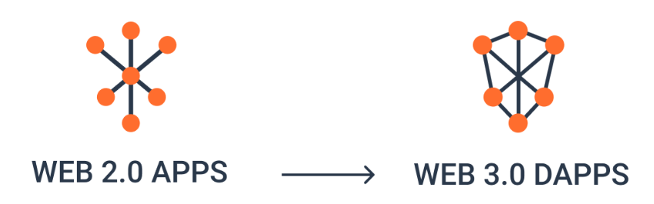
From Web2.0 to Web3.0
So far we have web2.0, ie the web as we knew it
DApps takes the www to its next natural evolutionary stage, introducing decentralization with peer-to-peer protocols into every aspect of a web application.
Notes:
At first glance, it may seem that interleaving and overlapping represent fundamentally different modes of execution and present different problems. In fact, both techniques can be viewed as examples of concurrent processing, and both present the same problems. In the case of a uniprocessor, the problems stem from a basic characteristic of multiprogramming systems: The relative speed of execution of processes cannot be predicted. It depends on the activities of other processes, the way in which the OS handles interrupts, and the scheduling policies of the OS.

Slide 8
From Web2.0 to Web3.0
This is called web3, ie the third “version” of the web.
First proposed by Gavin Wood, web3 represents a new vision and focus for web applications: from centrally owned and managed applications, to applications built on decentralized protocols.
In the future, industry expects more Dapp to be developed, and blockchain developers (including you) will be in great demand...
Notes:
At first glance, it may seem that interleaving and overlapping represent fundamentally different modes of execution and present different problems. In fact, both techniques can be viewed as examples of concurrent processing, and both present the same problems. In the case of a uniprocessor, the problems stem from a basic characteristic of multiprogramming systems: The relative speed of execution of processes cannot be predicted. It depends on the activities of other processes, the way in which the OS handles interrupts, and the scheduling policies of the OS.

Slide 9
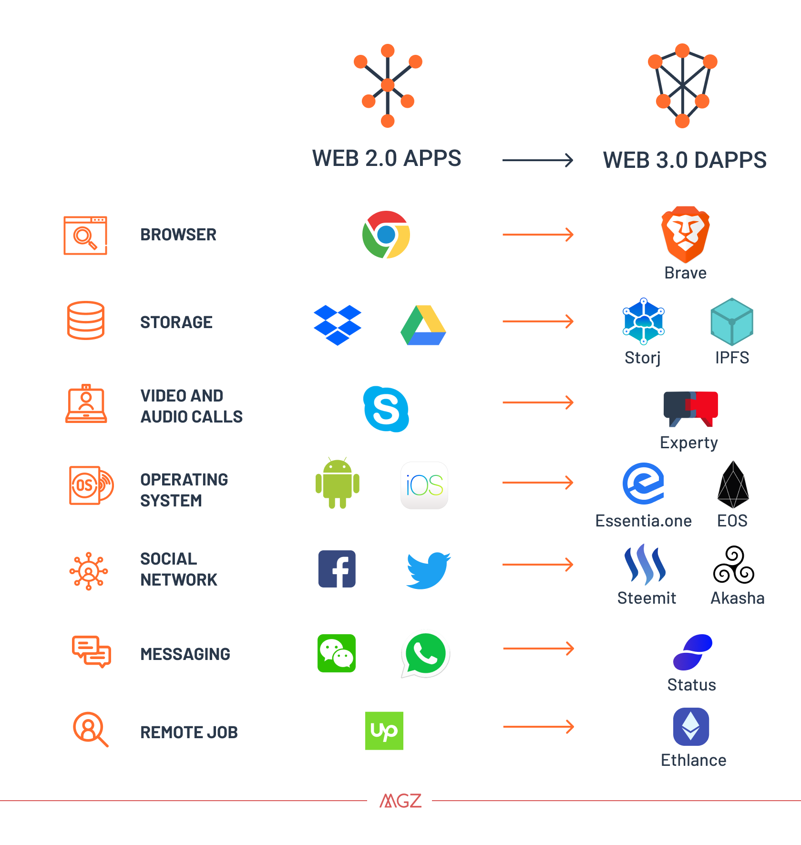
What is happening…
Notes:
At first glance, it may seem that interleaving and overlapping represent fundamentally different modes of execution and present different problems. In fact, both techniques can be viewed as examples of concurrent processing, and both present the same problems. In the case of a uniprocessor, the problems stem from a basic characteristic of multiprogramming systems: The relative speed of execution of processes cannot be predicted. It depends on the activities of other processes, the way in which the OS handles interrupts, and the scheduling policies of the OS.

Slide 10
Web3.0 & Javascript
Ethereum web3.js JavaScript library bridges JavaScript applications that run in browsers with the Ethereum blockchain.
Tutorial on web3.js – Appendix E, Antonopoulos
The web3.js library also includes an interface to a P2P storage network called Swarm and a P2P messaging service called Whisper.
With these three components included in a web3, developers have a full application development suite that allows them to build web3 DApps.
Notes:
At first glance, it may seem that interleaving and overlapping represent fundamentally different modes of execution and present different problems. In fact, both techniques can be viewed as examples of concurrent processing, and both present the same problems. In the case of a uniprocessor, the problems stem from a basic characteristic of multiprogramming systems: The relative speed of execution of processes cannot be predicted. It depends on the activities of other processes, the way in which the OS handles interrupts, and the scheduling policies of the OS.

Slide 11
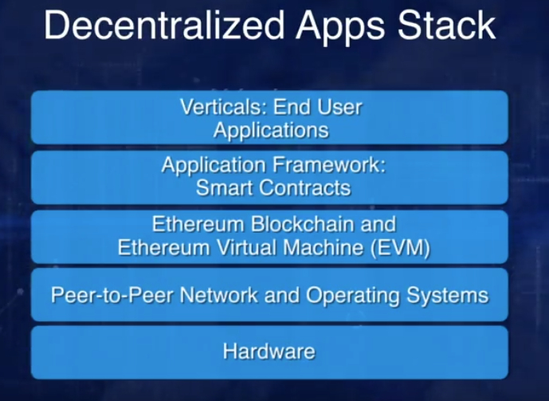
HL architecture of DApp
Web3-based end user application runs on the SC
The SC runs on top of the Blockchain
The node of the Blockchain runs an EVM
Blockchain operates on the p2p network
Notes:
At first glance, it may seem that interleaving and overlapping represent fundamentally different modes of execution and present different problems. In fact, both techniques can be viewed as examples of concurrent processing, and both present the same problems. In the case of a uniprocessor, the problems stem from a basic characteristic of multiprogramming systems: The relative speed of execution of processes cannot be predicted. It depends on the activities of other processes, the way in which the OS handles interrupts, and the scheduling policies of the OS.

Slide 12

Remix & Truffle
Remix is good for introducing SC programming, ie small projects.
Major SW projects, needs a SWE platform/IDE.
Truffle is an IDE for an end-to-end development of DApps.
Truffle is regarded as the Ethereum "Swiss Army Knife“
Read Appendix-D, Antonopoulos
Notes:
At first glance, it may seem that interleaving and overlapping represent fundamentally different modes of execution and present different problems. In fact, both techniques can be viewed as examples of concurrent processing, and both present the same problems. In the case of a uniprocessor, the problems stem from a basic characteristic of multiprogramming systems: The relative speed of execution of processes cannot be predicted. It depends on the activities of other processes, the way in which the OS handles interrupts, and the scheduling policies of the OS.

Slide 13

Truffle – motivation
Swiss army knife, Truffle packs together the best modules and tools to streamline smart contract creation, compilation, testing, and deployment onto Ethereum.
For veterans, the benefits of Truffle are obvious.
For newbies its quite a struggle !
But the IDE it provides is what is used in the industry in big serious software engineering project
Notes:
At first glance, it may seem that interleaving and overlapping represent fundamentally different modes of execution and present different problems. In fact, both techniques can be viewed as examples of concurrent processing, and both present the same problems. In the case of a uniprocessor, the problems stem from a basic characteristic of multiprogramming systems: The relative speed of execution of processes cannot be predicted. It depends on the activities of other processes, the way in which the OS handles interrupts, and the scheduling policies of the OS.

Slide 14
Truffle – the challenge
Written in JavaScript, Truffle modularizes key features to abstract away the complexity and cognitive load.
However, to be good will require us to dirty our hands a bit.
Check these introductory videos:
https://www.youtube.com/watch?v=xBA9IywgCeI&t=762s
https://www.youtube.com/watch?v=nRySHw123x8
Notes:
At first glance, it may seem that interleaving and overlapping represent fundamentally different modes of execution and present different problems. In fact, both techniques can be viewed as examples of concurrent processing, and both present the same problems. In the case of a uniprocessor, the problems stem from a basic characteristic of multiprogramming systems: The relative speed of execution of processes cannot be predicted. It depends on the activities of other processes, the way in which the OS handles interrupts, and the scheduling policies of the OS.

Slide 15
Important Websites
GitHub: https://github.com/trufflesuite/truffle
Website: https://truffleframework.com
Documentation: https://truffleframework.com/docs
Truffle Boxes: http://truffleframework.com/boxes/
npm package repository: https://www.npmjs.com/package/truffle
Download and install them
Notes:
At first glance, it may seem that interleaving and overlapping represent fundamentally different modes of execution and present different problems. In fact, both techniques can be viewed as examples of concurrent processing, and both present the same problems. In the case of a uniprocessor, the problems stem from a basic characteristic of multiprogramming systems: The relative speed of execution of processes cannot be predicted. It depends on the activities of other processes, the way in which the OS handles interrupts, and the scheduling policies of the OS.

Slide 16
Things to do…
These are interesting actions:
init
deploy
test
Notes:
At first glance, it may seem that interleaving and overlapping represent fundamentally different modes of execution and present different problems. In fact, both techniques can be viewed as examples of concurrent processing, and both present the same problems. In the case of a uniprocessor, the problems stem from a basic characteristic of multiprogramming systems: The relative speed of execution of processes cannot be predicted. It depends on the activities of other processes, the way in which the OS handles interrupts, and the scheduling policies of the OS.

Slide 17
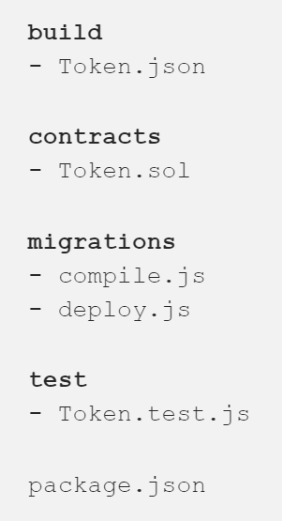
init
npm init - begin by initializing an empty node project
We create empty files and folders with this architecture:
the contracts folder houses all the solidity files. By convention, these files should be capitalized to indicate that solidity contracts are akin to “classes” from which contract “instances” are instantiated. In our case, it’s just Token.sol.
The migrations folder houses the scripts that we use to compile and deploy our contracts.
Running compile.js should compile all our solidity files into corresponding json files in the build folder.
compile.js: contracts/*.sol => build/*.json
In this case, as of now it’s just Token.json
Notes:
At first glance, it may seem that interleaving and overlapping represent fundamentally different modes of execution and present different problems. In fact, both techniques can be viewed as examples of concurrent processing, and both present the same problems. In the case of a uniprocessor, the problems stem from a basic characteristic of multiprogramming systems: The relative speed of execution of processes cannot be predicted. It depends on the activities of other processes, the way in which the OS handles interrupts, and the scheduling policies of the OS.

Slide 18
Deploy & test
When we run deploy.js, the bytecode inside our json files should be deployed onto the network of our choice, eg the local blockchain
deploy.js: build/*.json => network
Finally, the test folder houses all the test files. As of now, ie after “init”, it’s just Token.test.js
Such a project framework is typical in a SWE project, so you should get acquainted with it.
Notes:
At first glance, it may seem that interleaving and overlapping represent fundamentally different modes of execution and present different problems. In fact, both techniques can be viewed as examples of concurrent processing, and both present the same problems. In the case of a uniprocessor, the problems stem from a basic characteristic of multiprogramming systems: The relative speed of execution of processes cannot be predicted. It depends on the activities of other processes, the way in which the OS handles interrupts, and the scheduling policies of the OS.

Slide 19
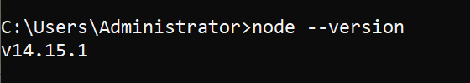
Nodejs
What is a nodejs?
Node = runtime environment for executing javascript code
Download it, and get the latest working version
Check the version installed > node --version
Notes:
At first glance, it may seem that interleaving and overlapping represent fundamentally different modes of execution and present different problems. In fact, both techniques can be viewed as examples of concurrent processing, and both present the same problems. In the case of a uniprocessor, the problems stem from a basic characteristic of multiprogramming systems: The relative speed of execution of processes cannot be predicted. It depends on the activities of other processes, the way in which the OS handles interrupts, and the scheduling policies of the OS.

Slide 20

solc
What is a solc?
Install it : npm install –g solc
Check the version installed > solcjs --version
Notes:
At first glance, it may seem that interleaving and overlapping represent fundamentally different modes of execution and present different problems. In fact, both techniques can be viewed as examples of concurrent processing, and both present the same problems. In the case of a uniprocessor, the problems stem from a basic characteristic of multiprogramming systems: The relative speed of execution of processes cannot be predicted. It depends on the activities of other processes, the way in which the OS handles interrupts, and the scheduling policies of the OS.

Slide 21
End of this slides set

